Slide 1
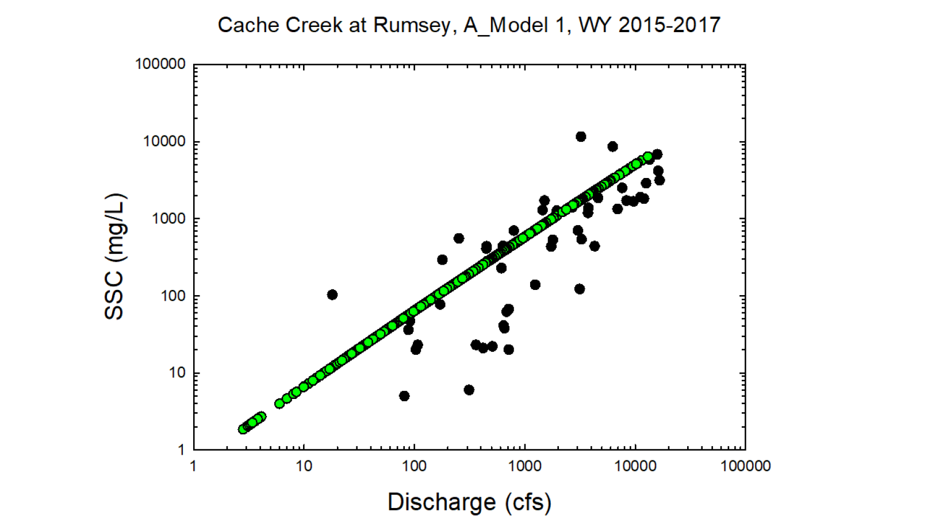
Black circles = Observed values
Green circles = Modeled values

Slide 2
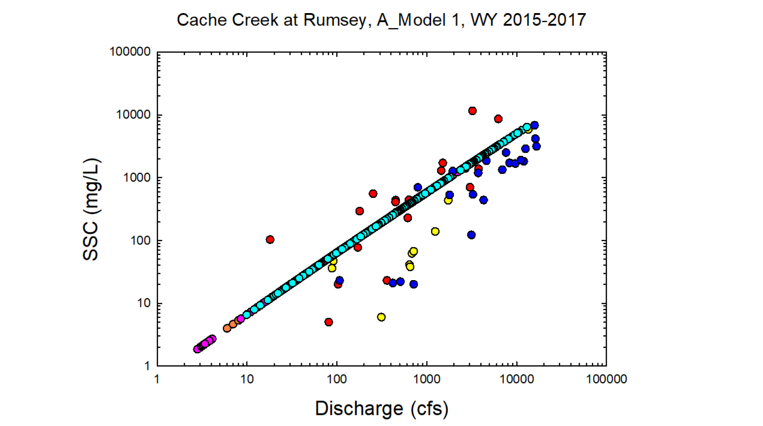
Yellow = Observed wy 2015
Red = Observed wy2016
Dk. Blue = Observed wy2017
Orange = Modeled wy2015
Pink = Modeled wy2016
Lt. Blue= Modeled wy2017

Slide 3
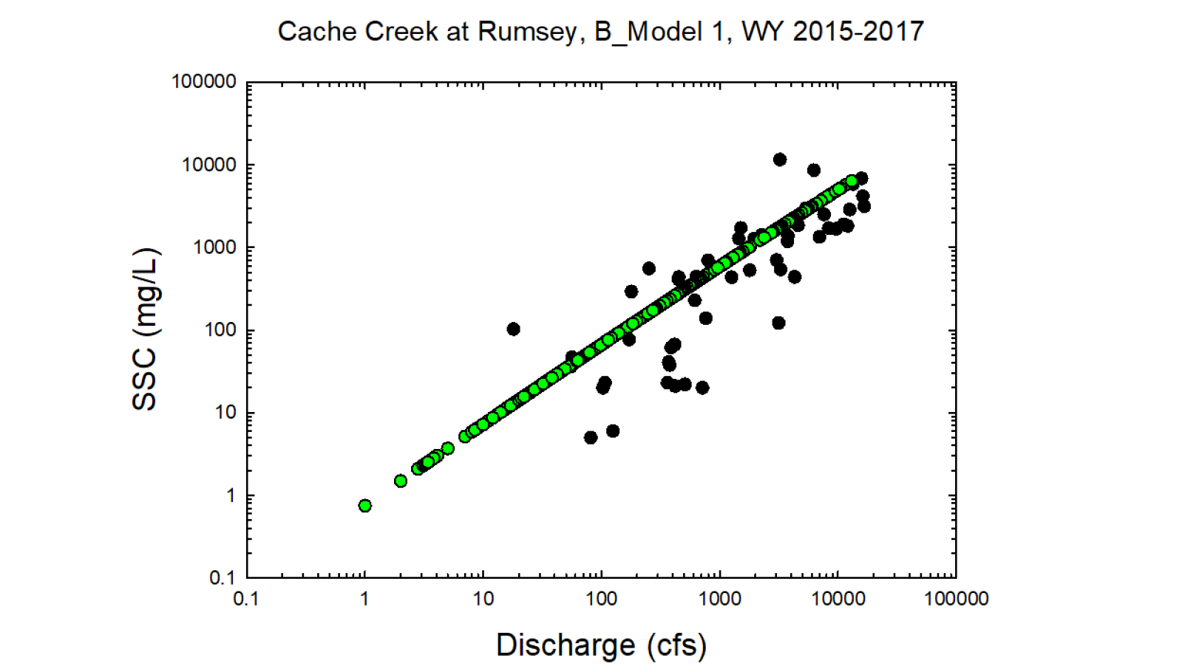
Black circles = Observed values
Green circles = Modeled values

Slide 4
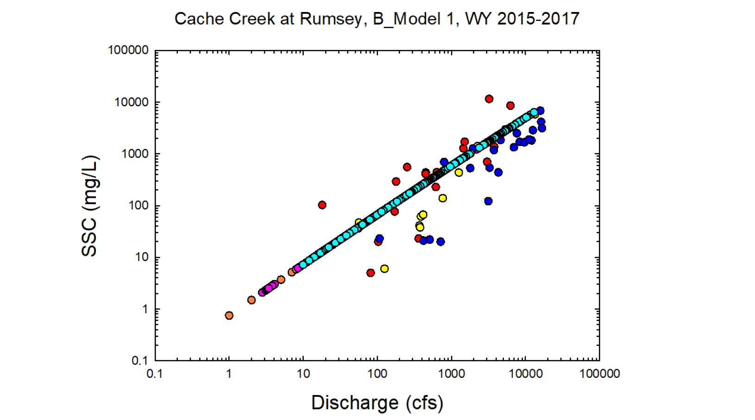
Yellow = Observed wy 2015
Red = Observed wy2016
Dk. Blue = Observed wy2017
Orange = Modeled wy2015
Pink = Modeled wy2016
Lt. Blue= Modeled wy2017

Slide 5
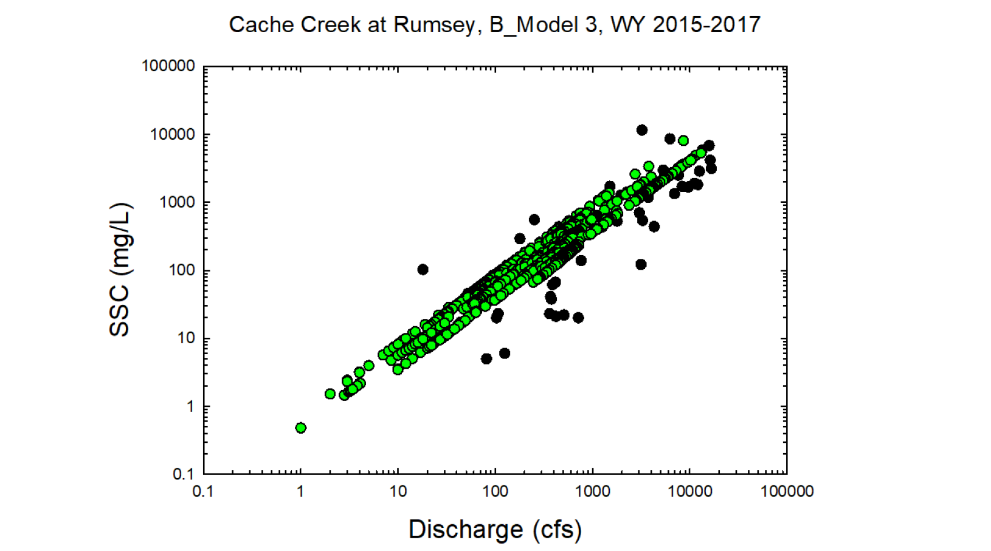
Black circles = Observed values
Green circles = Modeled values

Slide 6
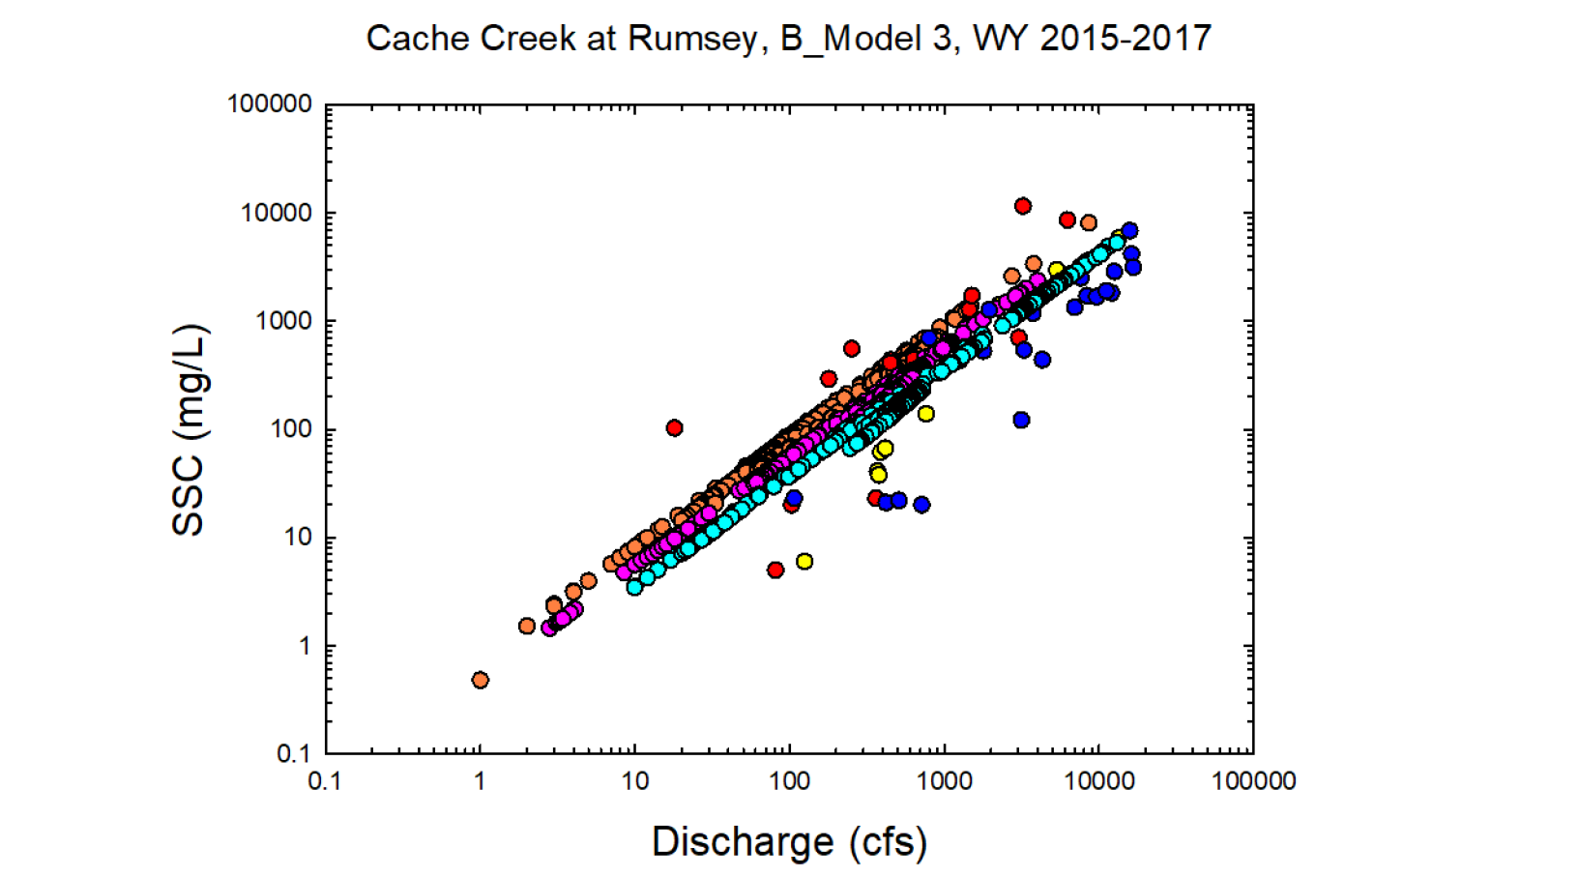
Yellow = Observed wy 2015
Red = Observed wy2016
Dk. Blue = Observed wy2017
Orange = Modeled wy2015
Pink = Modeled wy2016
Lt. Blue= Modeled wy2017

Slide 7
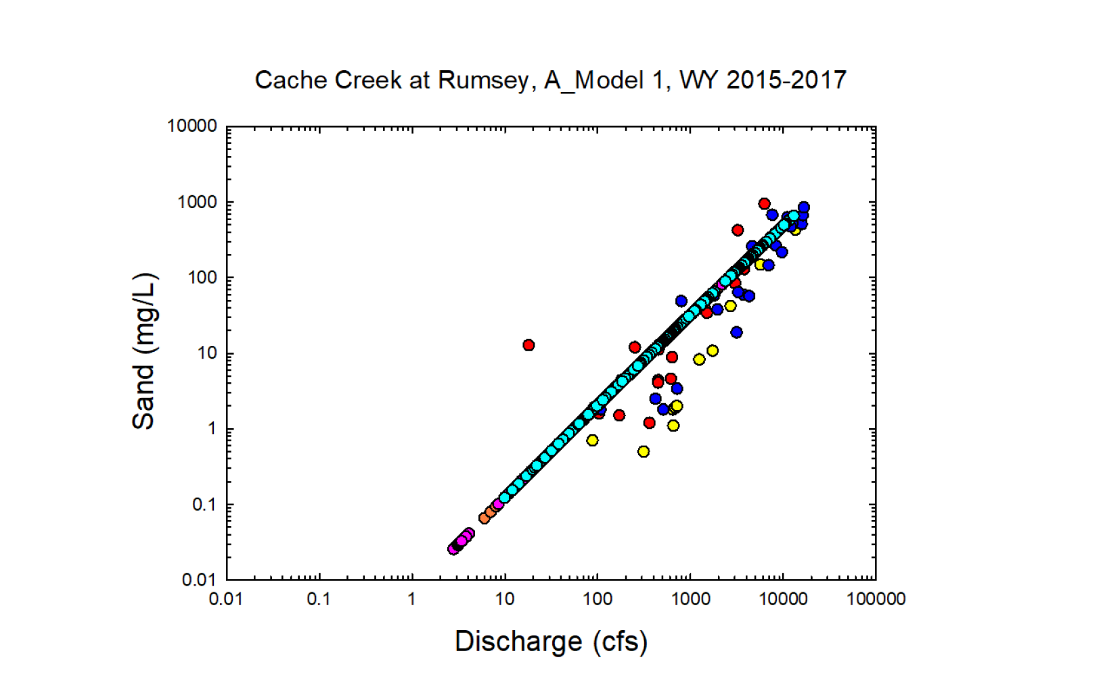
Yellow = Observed wy 2015
Red = Observed wy2016
Dk. Blue = Observed wy2017
Orange = Modeled wy2015
Pink = Modeled wy2016
Lt. Blue= Modeled wy2017

Slide 8
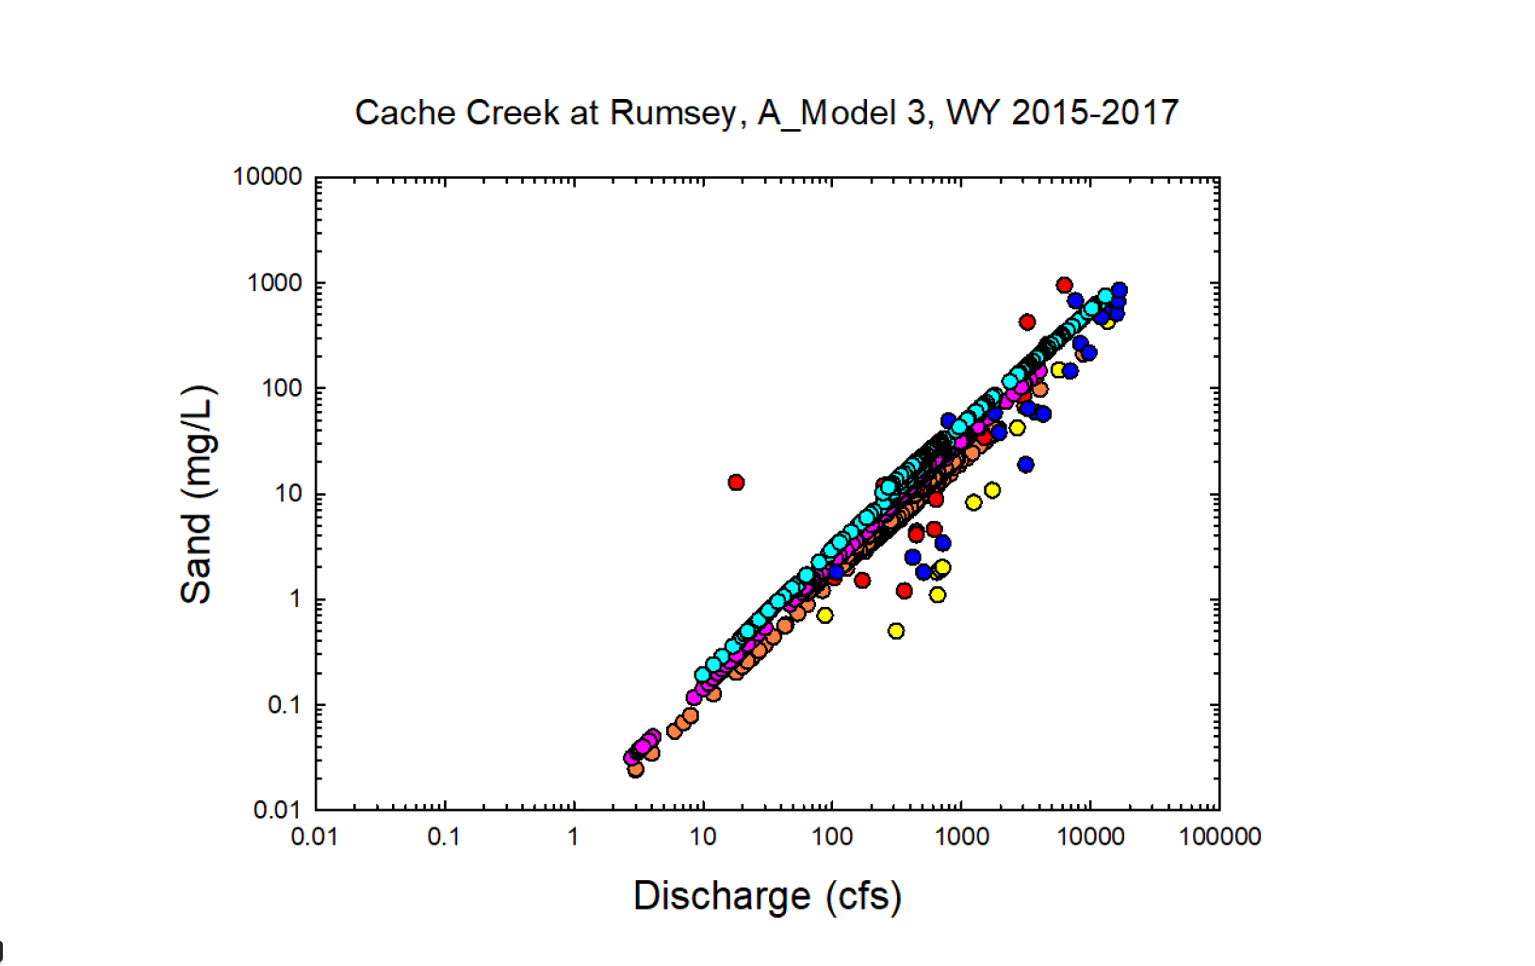
Yellow = Observed wy 2015
Red = Observed wy2016
Dk. Blue = Observed wy2017
Orange = Modeled wy2015
Pink = Modeled wy2016
Lt. Blue= Modeled wy2017

Slide 9
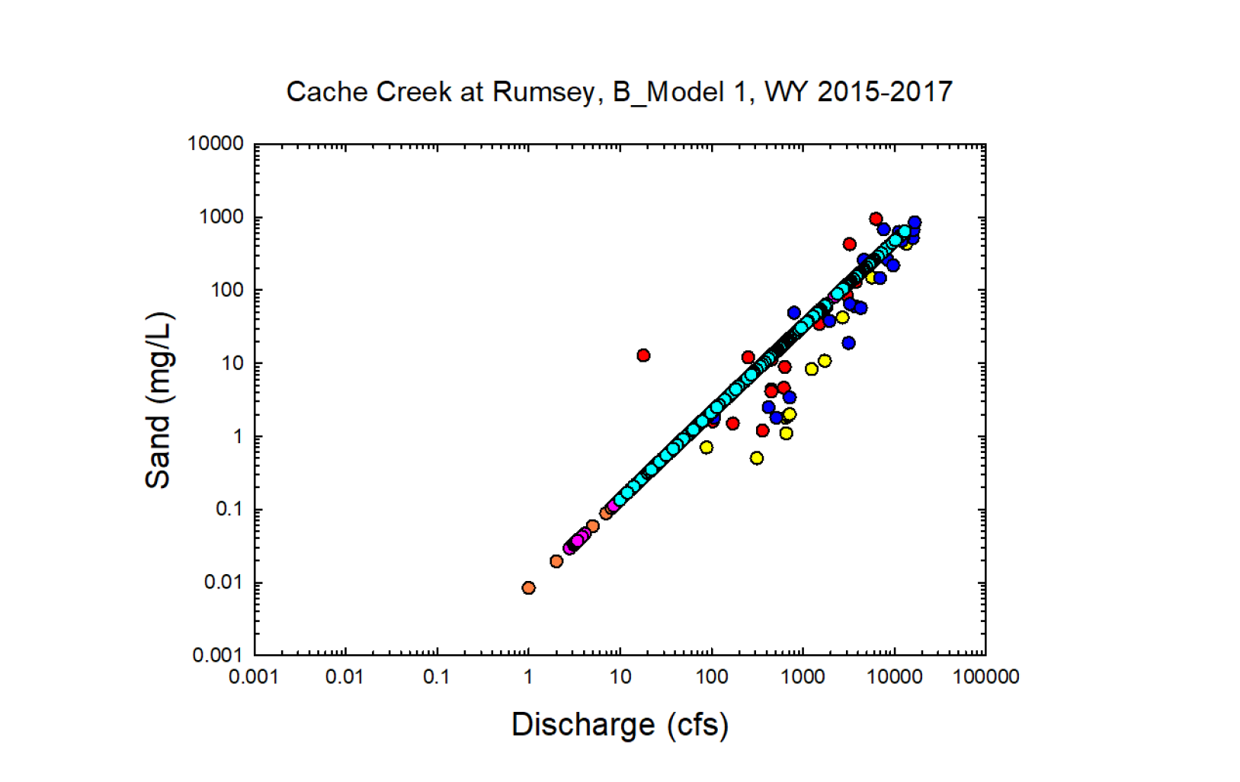
Yellow = Observed wy 2015
Red = Observed wy2016
Dk. Blue = Observed wy2017
Orange = Modeled wy2015
Pink = Modeled wy2016
Lt. Blue= Modeled wy2017

Slide 10
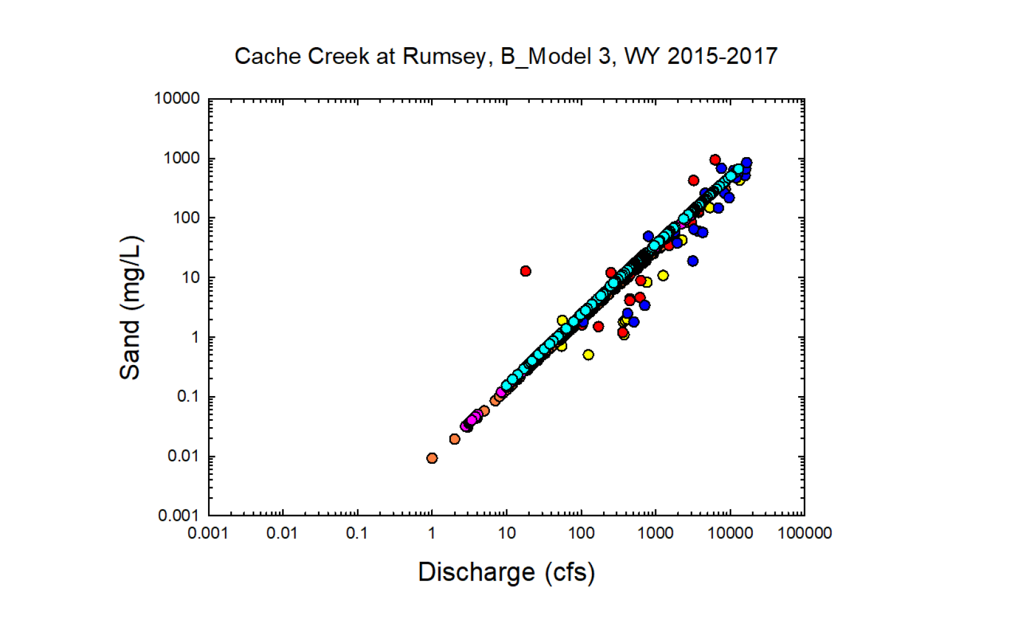
Yellow = Observed wy 2015
Red = Observed wy2016
Dk. Blue = Observed wy2017
Orange = Modeled wy2015
Pink = Modeled wy2016
Lt. Blue= Modeled wy2017

Slide 11
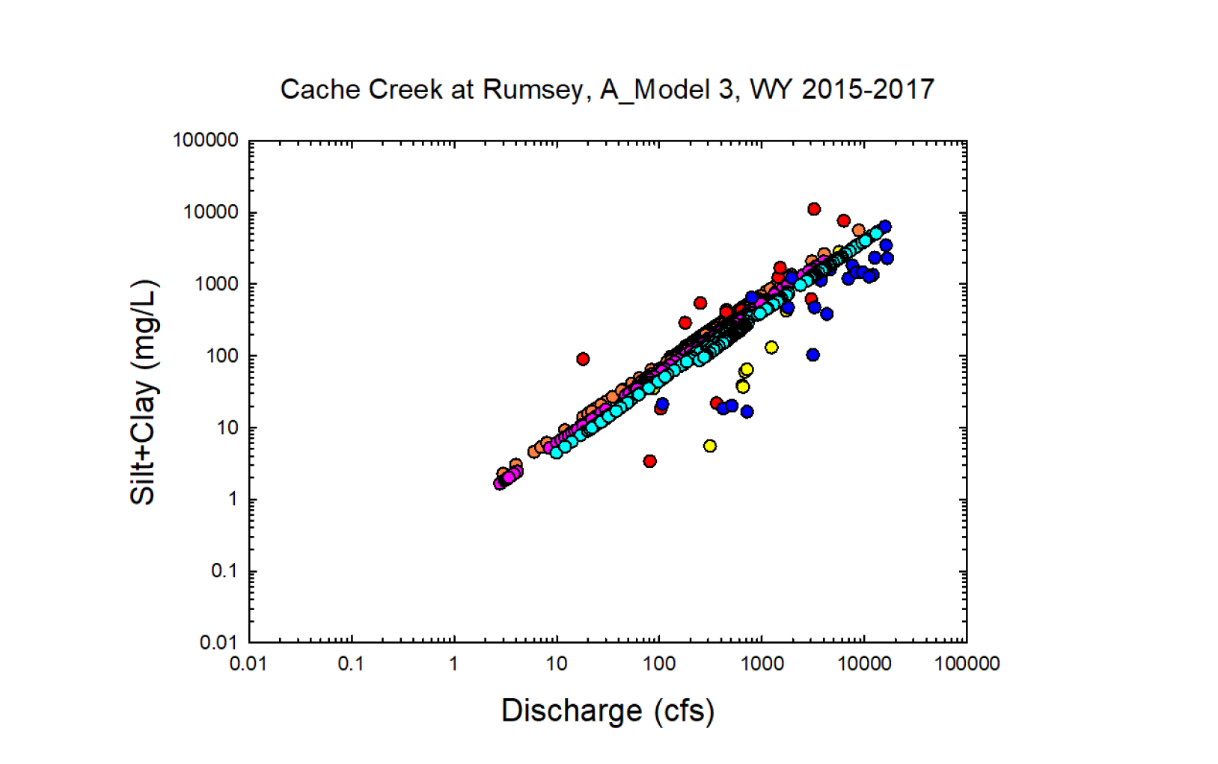
Yellow = Observed wy 2015
Red = Observed wy2016
Dk. Blue = Observed wy2017
Orange = Modeled wy2015
Pink = Modeled wy2016
Lt. Blue= Modeled wy2017

Slide 12
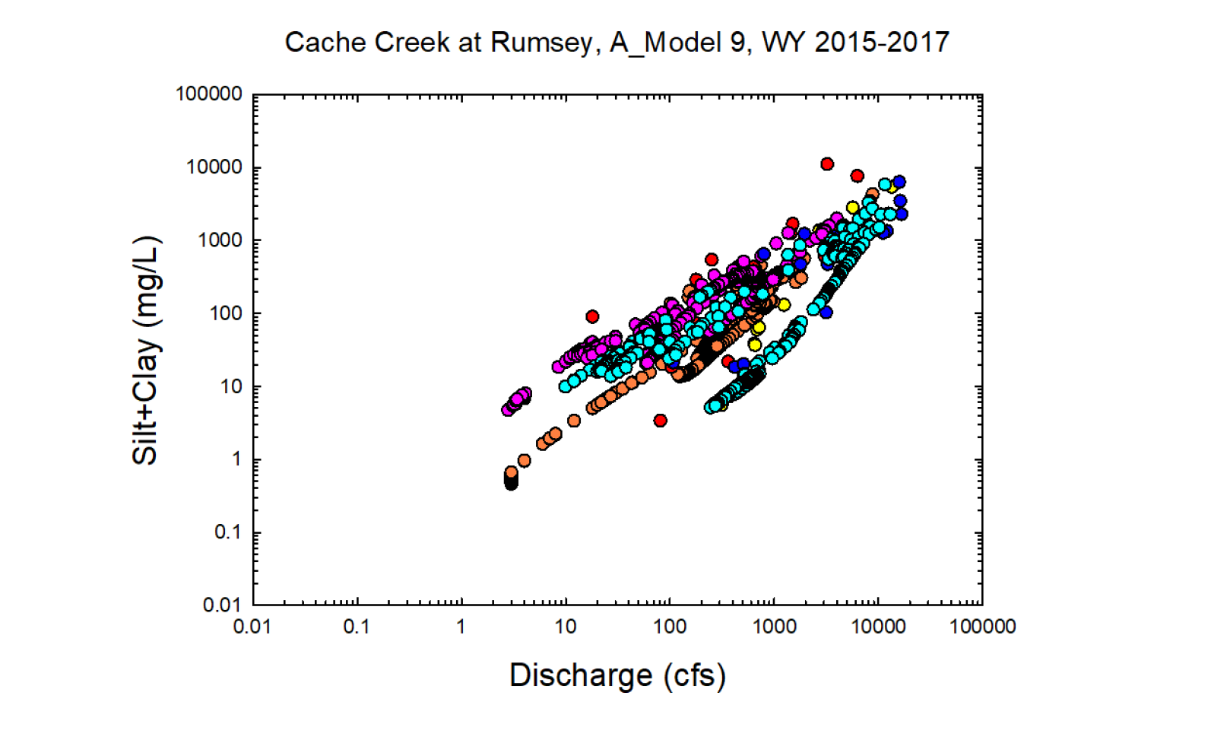
Yellow = Observed wy 2015
Red = Observed wy2016
Dk. Blue = Observed wy2017
Orange = Modeled wy2015
Pink = Modeled wy2016
Lt. Blue= Modeled wy2017

Slide 13
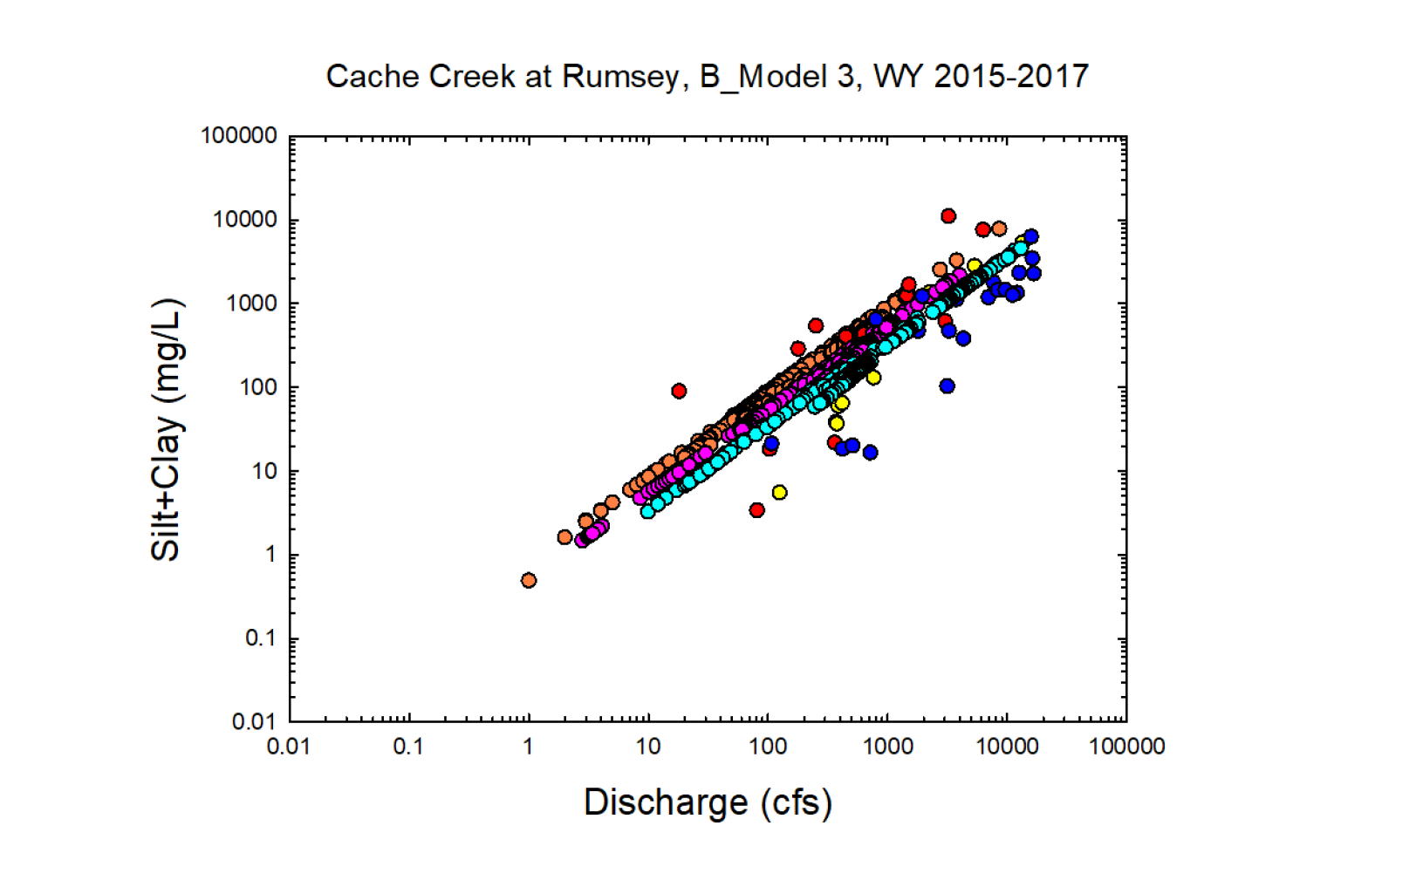
Yellow = Observed wy 2015
Red = Observed wy2016
Dk. Blue = Observed wy2017
Orange = Modeled wy2015
Pink = Modeled wy2016
Lt. Blue= Modeled wy2017

Slide 14
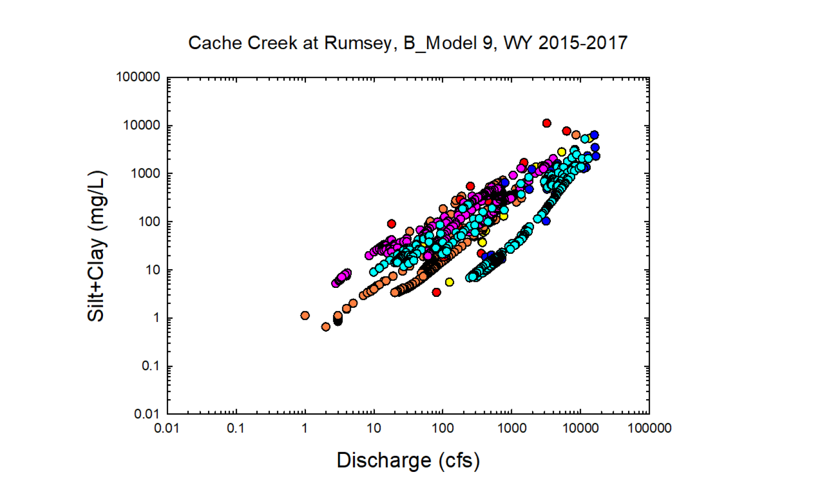
Yellow = Observed wy 2015
Red = Observed wy2016
Dk. Blue = Observed wy2017
Orange = Modeled wy2015
Pink = Modeled wy2016
Lt. Blue= Modeled wy2017

